Slide 1
INFO 7390 Advance DataSciences Midterm
By Team6
(Himaja Vadaga, Sandeep Kumar Bethi, Bryce Brako)

Slide 2
PROBLEM 1
Data for Credit Card Defaults:
This research aimed at the case of customers default payments in Taiwan and compares the predictive accuracy of probability of default among six data mining methods.
https://archive.ics.uci.edu/ml/datasets/default+of+credit+card+clients

Slide 3
Summary OF Observations
POWER BI
Cleansing
Classification using Logistic Regression
Classification using Regression Trees
Classification using Artificial Neural Networks
Final Conclusion

Slide 4
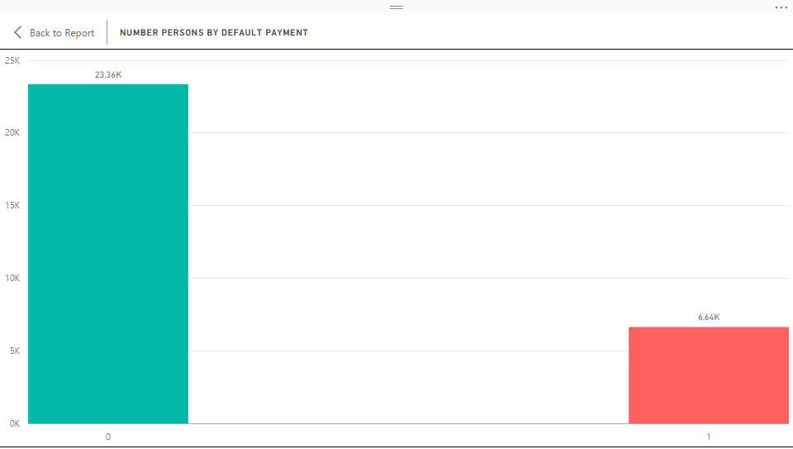
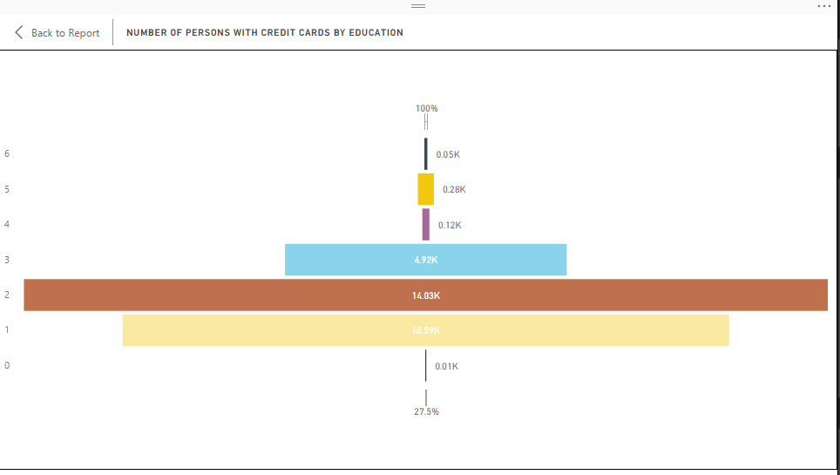
POWER BI

Slide 5
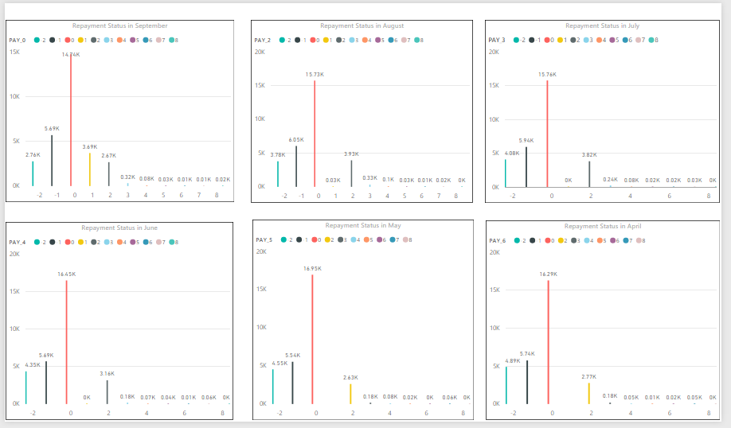
POWER BI

Slide 6
Cleansing
The file was obtained in xls format. Converted the format to .csv and then loaded it into R.
On loading the dataset into R, the column names were not human readable and a reference to the 1st row had to be used to understand what the value of the column is. Thus used the first row as the column names renamed the columns. In order to achieve this used the rename function of the PLYR library.
There were around 795 rows which had the Bill amounts and the payment amount values for all the months as 0. So, deleting the rows to make sure an efficient model is built.

Slide 7
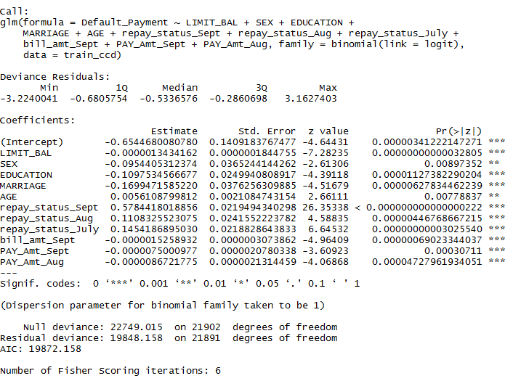
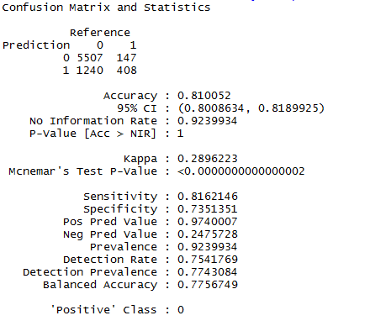
Classification using Logistic Regression

Slide 8
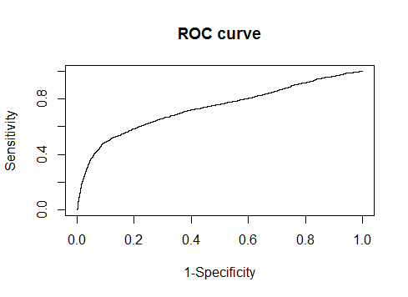
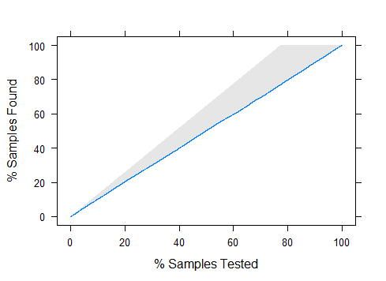
Classification using Logistic Regression

Slide 9
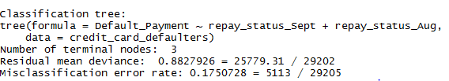
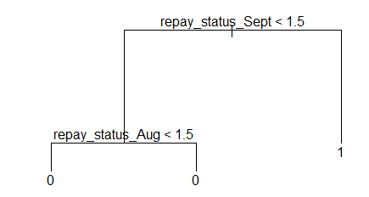
Classification using Regression Trees

Slide 10

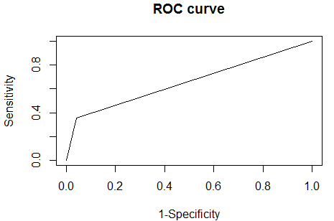
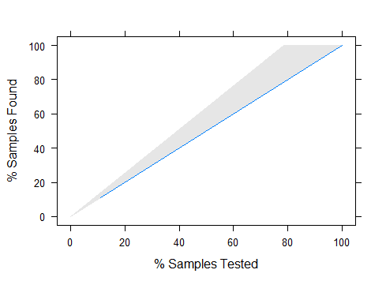
Classification using Regression Trees

Slide 11

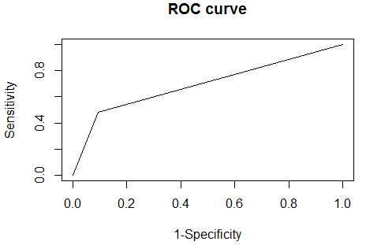
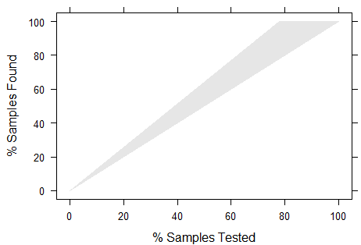
Classification using Artificial Neural Networks

Slide 12
FINAL CONCLUSION
Logistic Regression Error rates
Overall Error rate is 18%
Non-Defaulter Error Rate (0) = 2%
Defaulter Error Rate (1) = 75%
Regression Trees Error Rates
Overall Error Rate = 17%
Non-Defaulter Error Rate (0) = 15%
Defaulter Error Rate (1) = 42%
Artificial Neural Network Error Rates
Overall error Rate = 17%
Non-Defaulter Error Rate (0) = 5%
Defaulter Error Rate (1) = 61%
On Calculating the Overall Error Rate for all the tree model, based on the classification tree having the better error rate calculations compared to the logistic regression and neural network model we would choose the Classification tree model.

Slide 13
Problem 2-Internet Advertisements
This dataset represents a set of possible advertisements on Internet pages.
The features encode the geometry of the image (if available)
As well as phrases occuring in the URL, the image's URL and alt text, the anchor text, and words occuring near the anchor text.
The task is to predict whether an image is an advertisement ("ad") or not ("nonad")

Slide 14
Data Cleansing and Pre-Processing
Challenges faced while cleansing and pre-processing the data
Replacing the “?” values by NA in continuous data i.e for the first three columns
Estimating and Replacing the outliers for continuous data by NA’s
Replacing all the NA’s by appropriate values in continuous data (we are not simply deleting the records as suggested in the pdf)
Dimensionality reduction since the number of features for this dataset is huge

Slide 15
Dimension Reduction
Since the size of variables or features is huge = 1559, we implemented PCA for clusters of features and reduced the features down to 498- this is excluding the Ad_Class variable.

Slide 16
Classification Trees- Statisitcs
ConfusionMatrix_TreePruined
Ad_Class.test
prune.pred ad. nonad.
ad. 192 15
nonad. 32 1401
The overall error rate for the tree model which is pruned= ((32+15)/1640)*100
Overall error rate_TreePruined=2.8%
NOTE: The overall error rate has come down after Pruning from 4.3% to 2.8%
Error rate and accuracy in prediciting each individual class
Error rate in Predicting Ad class= 14/207= 7.2%
Accuracy in Predicting Ad class= 187/207= 92.7%
Error rate in Predicitng NonAD class= 32/1433= 2.2%
Accuracy in Predicitng NonAD class= 1401/1433= 97.7%
This tree model which is not pruned is more accurate in predicting NonAD classes.

Slide 17
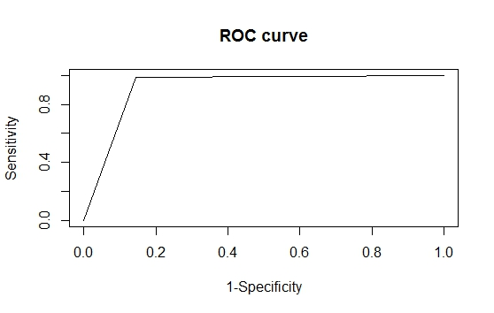
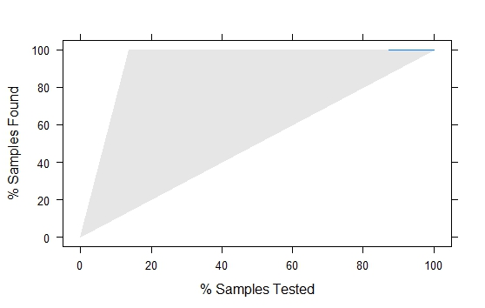
Classification Tress-ROC and LIFT

Slide 18
Conclusion-Classification Tree
Conclusion from classification tree model: Since the performance metrics and confusion matrix looks better after the tree is pruned we are considering this model which is pruned as our final classification tree model. The error rate from this model is 2.8%

Slide 19
LOGISTIC REGRESSION-STATISTICS
Confusion Matrix and Statistics
Reference
Prediction ad. Nonad.
Ad. 23 94
nonad. 677 26
Error rate and accuracy in prediciting each individual class
Error rate in Predicting Ad class= 94/117= 80.3%
Accuracy in Predicting Ad class= 23/117= 19.65%
Error rate in Predicitng NonAD class= 680/703= 96.3%
Accuracy in Predicitng NonAD class= 26/703= 3.6%
As we can see above the overall error rate is too high for the logistic regression model.
It predicts only 26AD cases correctly as ad and it predicts 94 AD cases wrongly as nonad
It Predicts only 26 NONAD cases correctly as nonad and it predicts 680 NONAD cases wrongly as ad
Since the accuracy rate of predicting AD class correctly is more than the accuracy of redicting NONAD class it is considered as a positive class for ad.

Slide 20
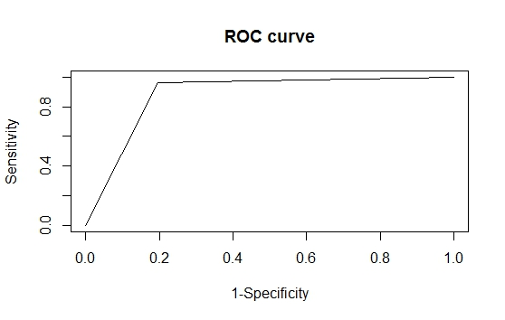
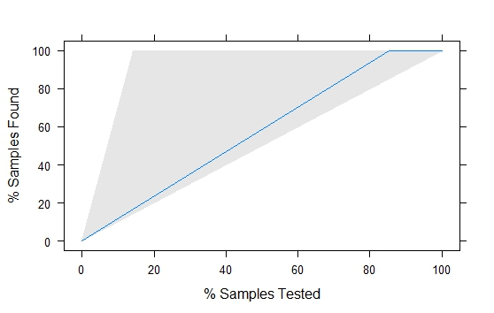
LOGISITC-ROC AND LIFT

Slide 21
NEURAL NETWORK-STATISTICS
ConfusionMatrix_Neural_Network
test.nnet
ad. nonad.
ad. 123 22
nonad. 9 830
Overall Error Rate= ((22+9)/(984))*100
= 3.1
Error rate and accuracy in prediciting each individual class
Error rate in Predicting Ad class= 22/145= 15.1%
Accuracy in Predicting Ad class= 123/145= 84.8%
Error rate in Predicitng NonAD class= 9/839= 1%
Accuracy in Predicitng NonAD class= 830/839= 98.9%

Slide 22
NEURAL NETWORK-STATISITCS
As we can see above the overall error rate is 3.1% for the neural network model.
It predicts only 123 AD cases correctly as ad and it predicts 22 AD cases wrongly as nonad
It Predicts only 830 NONAD cases correctly as nonad and it predicts 9 NONAD cases wrongly as ad
This model is more accurate in predicting the NonAD cases.

Slide 23
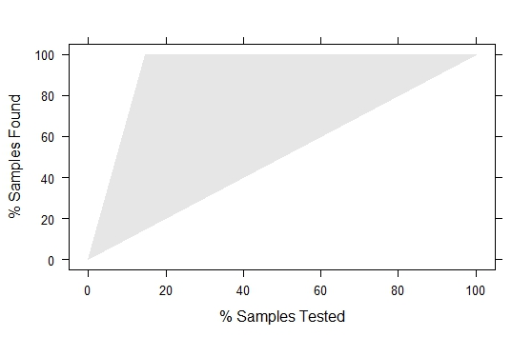
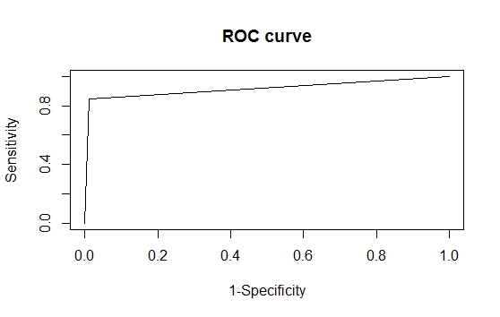
NEURAL NETWORK-ROC and LIFT

Slide 24
FINAL CONCLUSION-PROBLEM 2
FINAL CONCLUSION FOR PROBLEM 2 which model we would choose
After comparing the performance metrics of all the three classification models for the dataset Internet Advertisements-Problem 2 we decided that we would choose Classification trees model. We have decided this because the overall error rate is less in that model compared to other two models. Also the accuracy and error rates in predicting the individual classes: Ad, NonAd is better in Classification trees model than the other two models.

Slide 25
PROBLEM-2 REFERENCES
Internet Advertisments
http://www.fileformat.info/tip/web/imagesize.html
http://www.r-bloggers.com/computing-and-visualizing-pca-in-r/
http://www.sc.ehu.es/ccwbayes/docencia/mmcc/docs/lecturas-clasificacion/abstracts-resumir/kushmerick99learning.pdf

